Slide 1

Menu Helper
May Merkle-Tan, PhD
hengrumay@gmail.com
Notes:
Introduce myself! =)

Slide 2

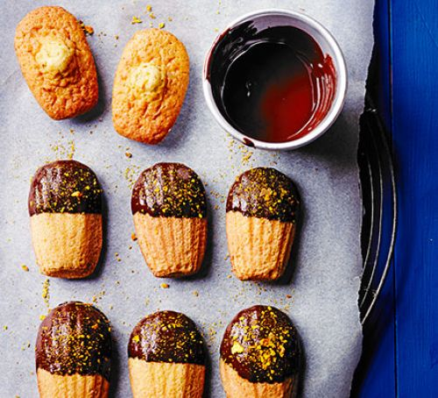
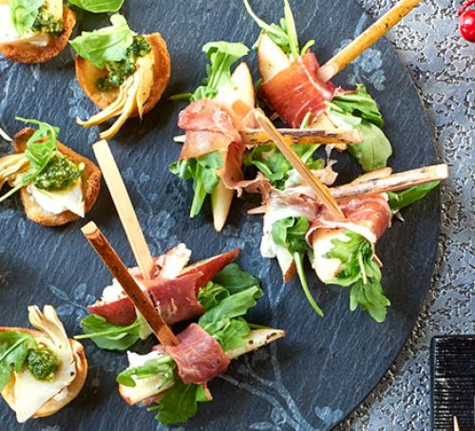
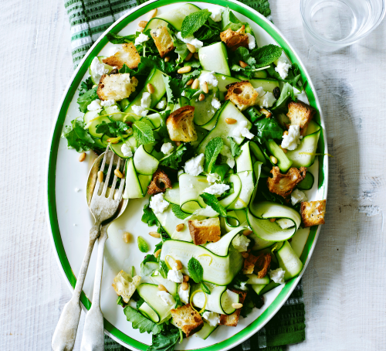
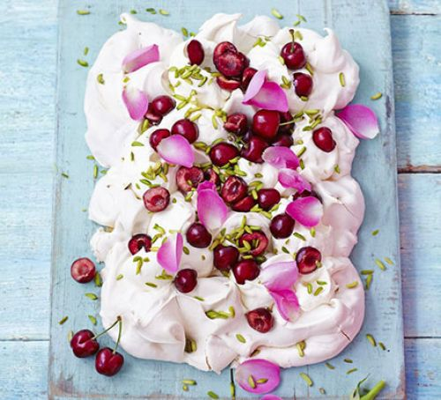
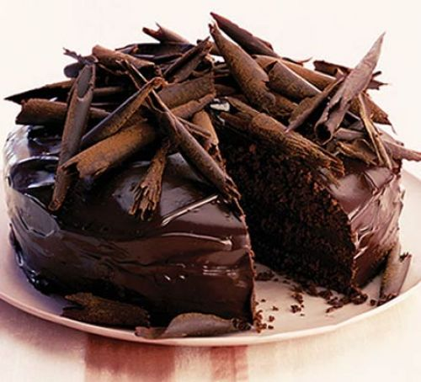
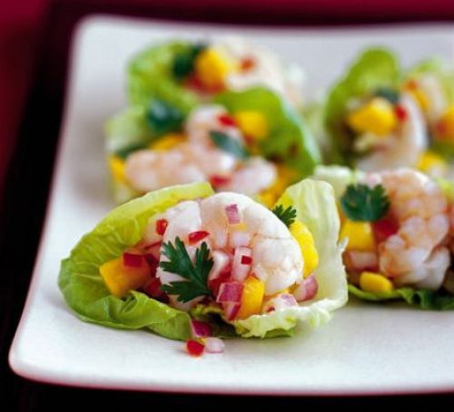
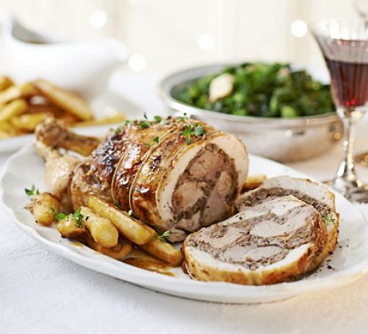
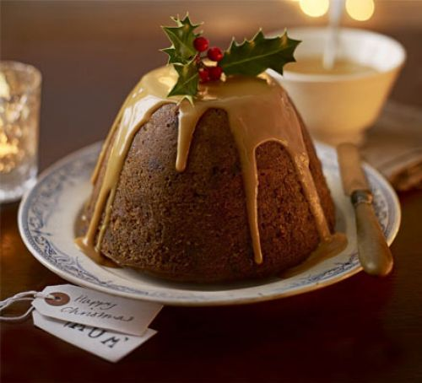
T’is the season to be jolly…
Notes:
Some of us will be busy planning for the family xmas meal… while others might be fantasizing about what they’ll be enjoying…
TRY to link this directly to classification
These are pretty ambitious dishes

Slide 3
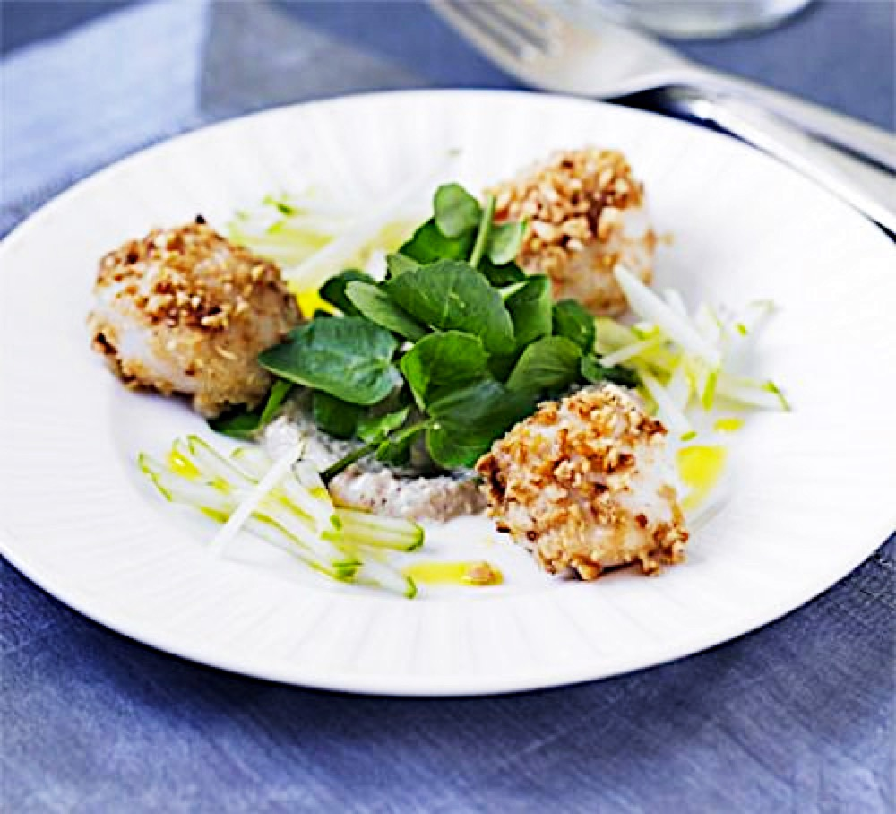
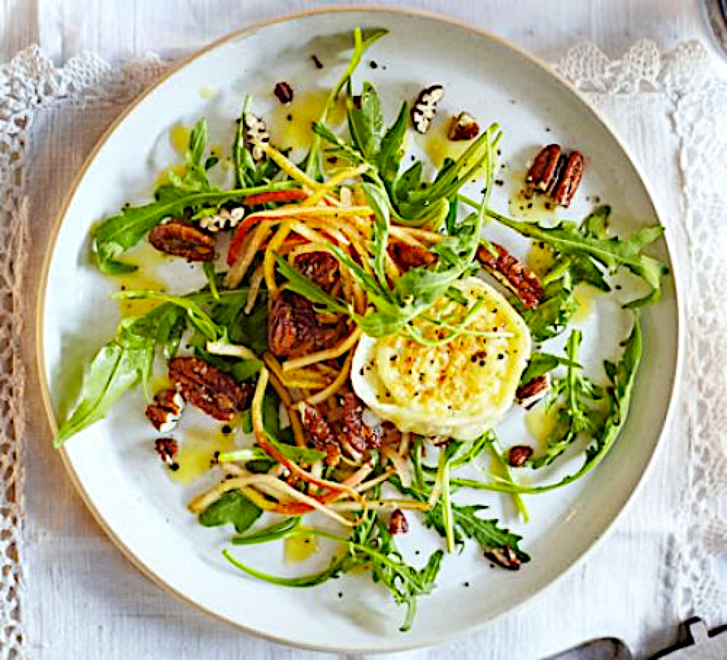
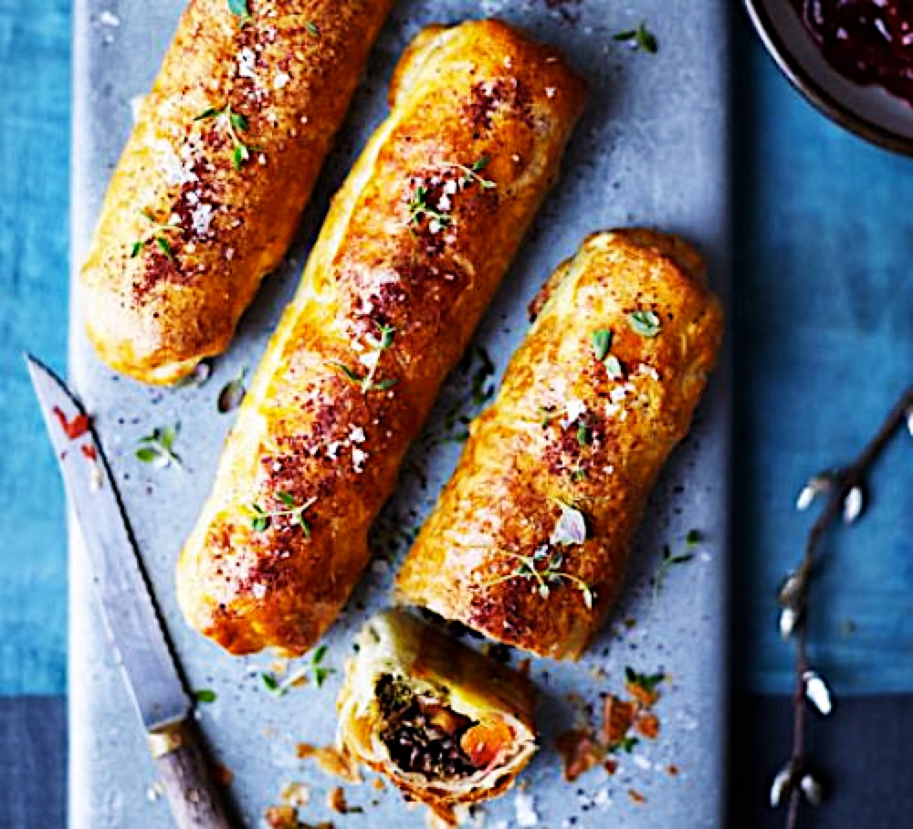
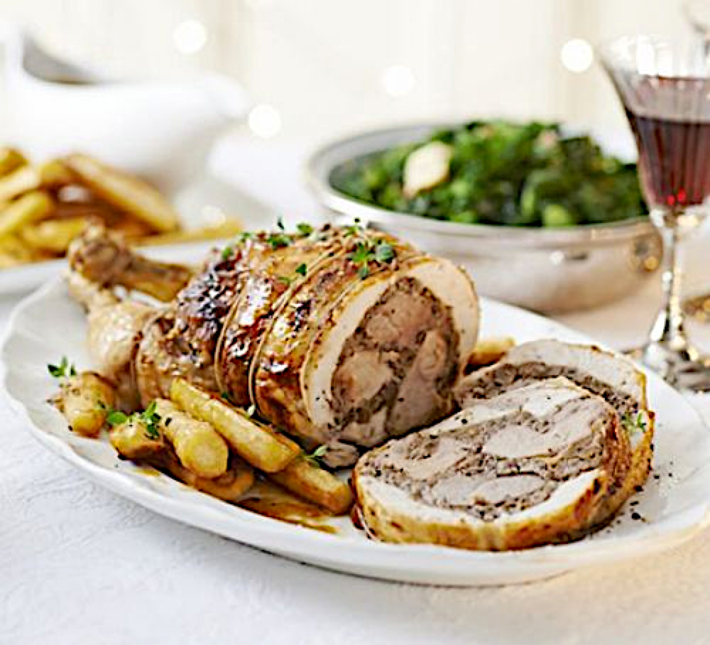
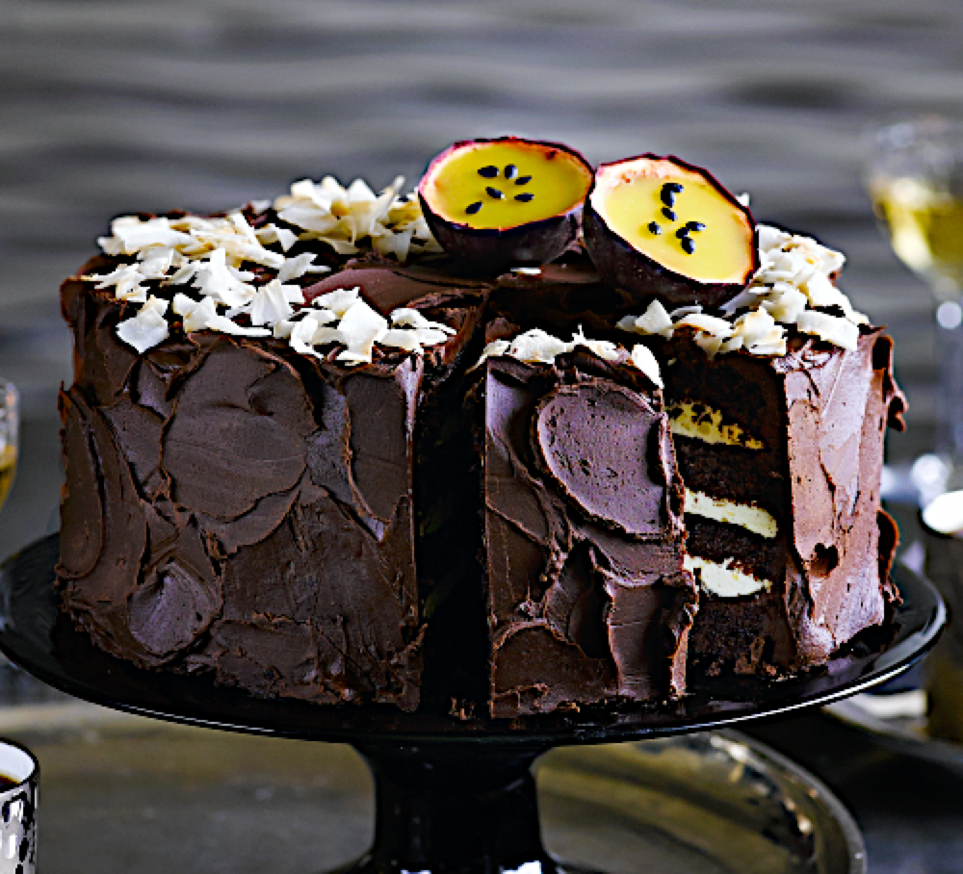
T’is the season to be jolly…
A Splendid Table
Scallop & apple salad with hazelnut dressing
Goat’s cheese, pear & candied pecan salad
Beetroot & squash Wellingtons with kale pesto
Chestnut & wild mushroom stuffed three-bird roast
Dark chocolate, coconut & passion fruit mousse cake
Notes:
As we gradually decide on the festive menu another thing comes to mind – how might we juggle the various logistics & many moving parts involved in putting together a festive meal for a group of people?
Indeed careful coordination is needed to minimize kitchen disasters…. !
TRY to link this directly to classification
These are pretty ambitious dishes

Slide 4
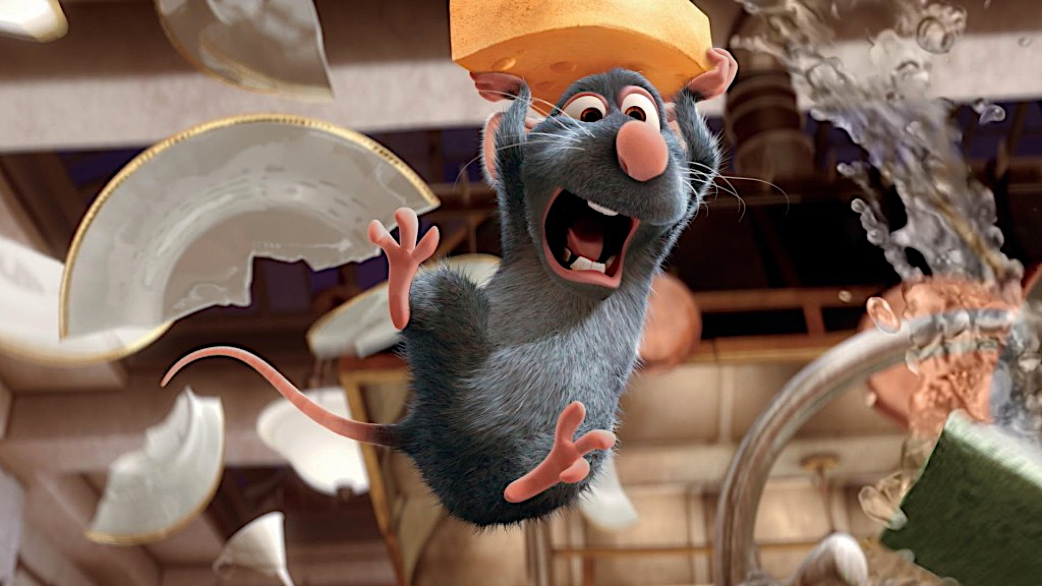

Notes:
TRY to link this directly to classification
These are pretty ambitious dishes

Slide 5
Not all recipes are created equal
Ingredients
Equipment
How can we simplify planning & cooking?
Preparation time
What aspects of a recipe make it challenging?
Cooking time
Can we classify recipes by their “difficulty”?
**very few sites/books include this info.!
Difficulty?
http://www.marthastewart.com/1106683/french-macarons-basic-recipe
http://www.foodnetwork.com/recipes/food-network-kitchens/french-macarons.html
Notes:
How can we make multi-tasking easier? Having too many difficult recipes to work with might be too stress-inducing…

Slide 6
Steps to creating a recipe-difficulty-tagger
Data
&
Pre-processing
Scraped ≈10,100 recipes from BBCgoodfood.com
New York Times CRF-recipe-phrase-tagger : teasing out ‘ingredient’ tokens & excluding quantity /units
NLP | Tokenization: creating word tokens for each recipe
Topic Modeling
&
Classification:
“Topic-modeling” : Latent Dirichlet Allocation (LDA) -- LDA transformed matrices yield a dimensionality reduced token-association matrix
Ingredients
Instructions
β₁LDA_{ingredients} + β₂LDA_{instructions} + β₃prep_{time} + β₄cook_{time} + β₅N_{ingredients} ≈ “difficulty” ?
Post-tagging
Usage:
K-NearestNeighbours
on LDA_{ingredients}
find K similar recipes based on ingredients
what are other similar recipes?
For a given recipe:
what are other recipes’ “difficulty” class?
Notes:
Latent Dirichlet Allocation (LDA)
Data acquisition + preprocessing:
Scraped recipes from BBCgoodfood.co.uk
NYT-CRF_recipe-phrase-tagger : helps tease out ‘ingredient’ terms & exclude quantity /units
NLP Tokenization: creating word tokens for each recipe
Topic Modeling & Classification:
“Topic-modeling” : Latent Dirichlet Allocation (LDA) -- LDA transformed matrices yield a dimensionality reduced word-association matrix
Ingredients
Instructions
LDA_ing + LDA_instr + prep_time + cook_time + Ningred → “difficulty” ??
Post-tagging extension:
For a given recipe – what are other similar recipes & what are their “difficulty” class?
Latent Dirichlet Allocation is a generative probabilistic model for collections of discrete dataset such as text corpora. It is also a topic model that is used for discovering abstract topics from a collection of documents.
The graphical model of LDA is a three-level Bayesian model:
http://scikit-learn.org/stable/modules/decomposition.html#latentdirichletallocation

Slide 7
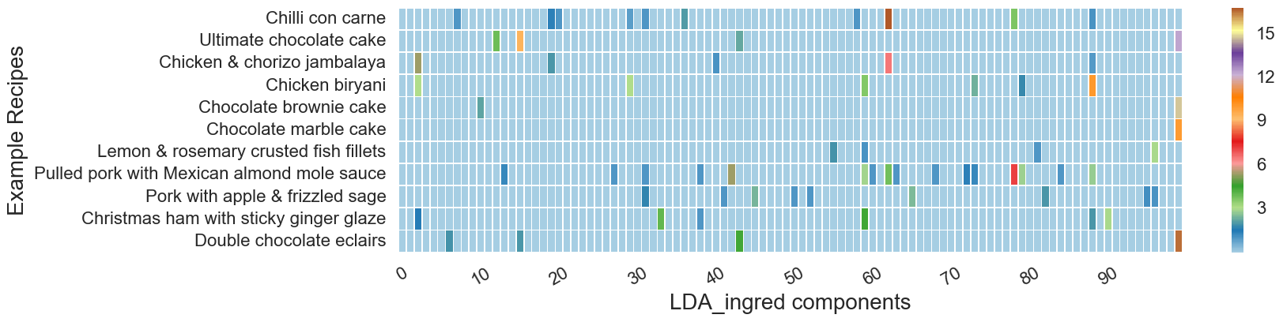
LDA topic-modeling
0 Chilli con carne
1 Ultimate chocolate cake
2 Chicken & chorizo jambalaya
3 Chicken biryani
4 Chocolate brownie cake
5 Chocolate marble cake
6 Lemon & rosemary crusted fish fillets
7 Pulled pork with Mexican almond mole sauce
8 Pork with apple & frizzled sage
9 Christmas ham with sticky ginger glaze
10 Double chocolate eclairs
Example Recipes
LDA_ingredient Topics
Notes:
Every recipe can be described by a prob. distr. of ingredient topics. — some of which will be stronger.
Recipes are represented as a combination of ingredient component strengths
LDA transformed matrices yield a dimensionality reduced ingredient token-association matrix
The model components capture the word token associations in a probabilistic way --- some components highlight where recipes share similarities;
sometimes a combination of many components are necessary to characterize certain types of dishes… e.g. mole

Slide 8
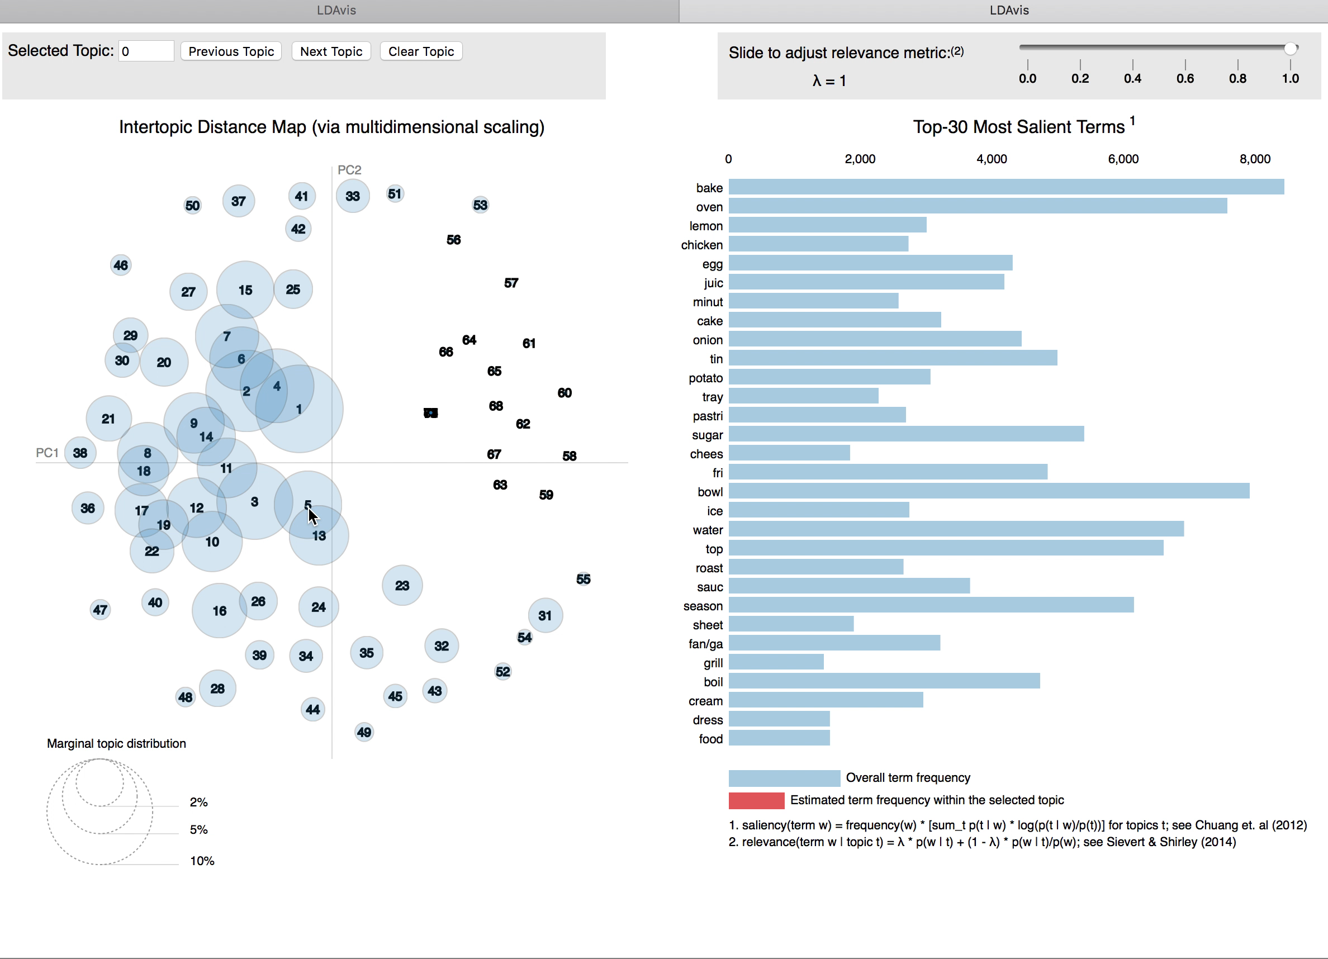
LDA topic-modeling
Notes:
##
Another way to visualize the topic modelling is shown here for the recipe instructions
Some recipes are associated by being related to the equipment or type of cooking techniques e.g. baking / or involve certain types of ingredients ….
Try to time the description with the output of the pyLDAvis

Slide 9
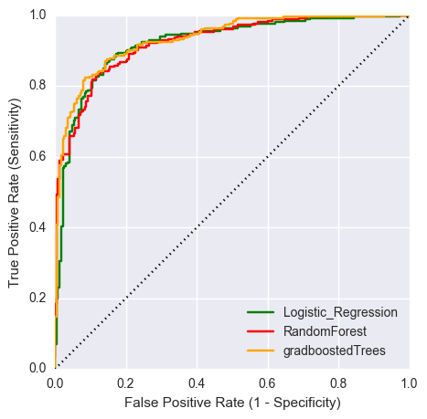
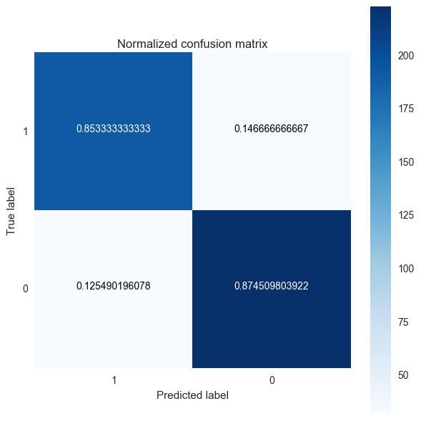
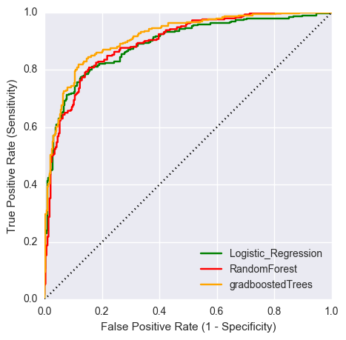
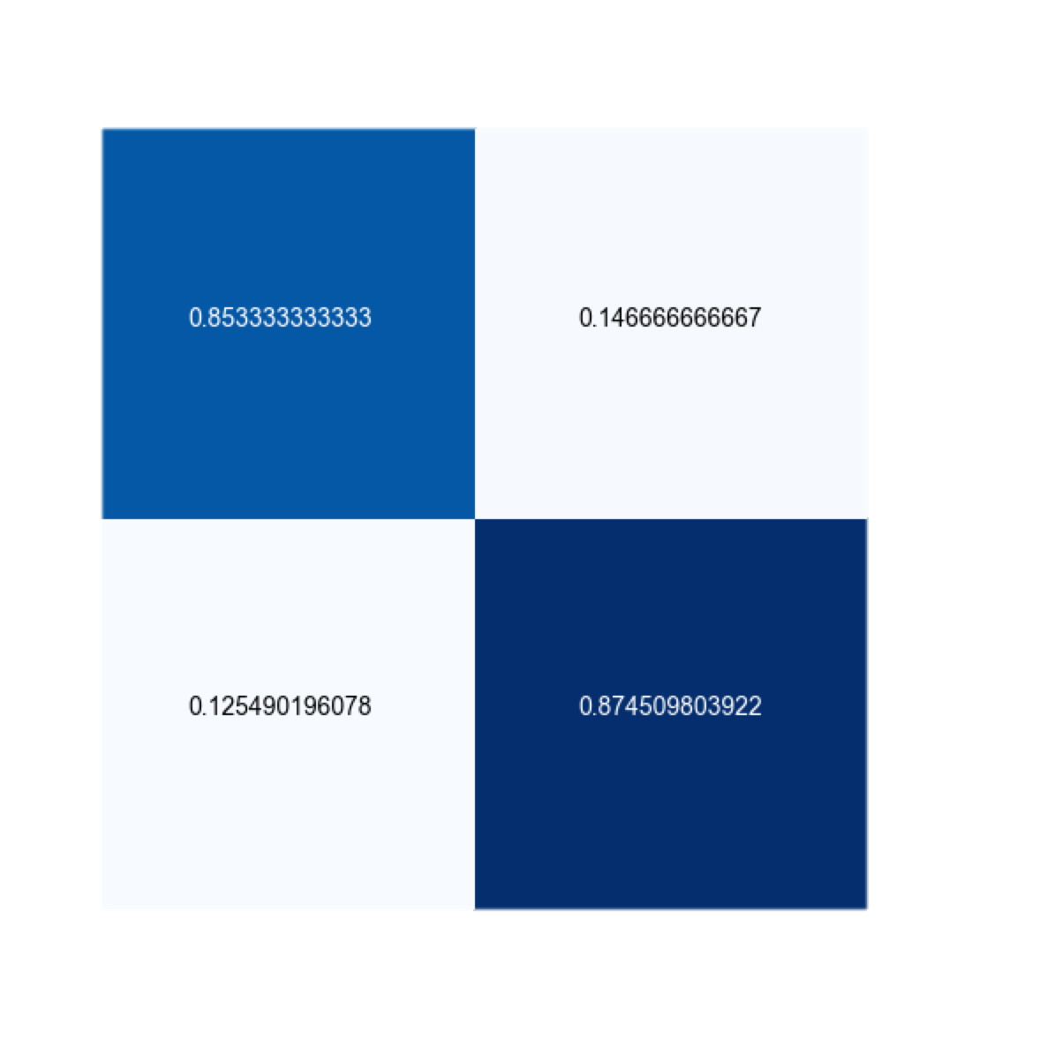
Classification outcomes on hold-out data:
Model: Logistic_Regression
AUC_test: 0.80
AUC_holdout: 0.86
Model: RandomForest
AUC_test: 0.82
AUC_holdout: 0.85
Model: gradboostedTrees
AUC_test: 0.84
AUC_holdout: 0.86
0.853
0.147
0.125
0.875
Notes:
ROOM for further improvements…
≈86% precision & recall
precision recall f1-score support
0 0.86 *0.85 0.86 225
1 0.87 *0.87 0.87 255
avg / total 0.86 0.86 0.86 480

Slide 10
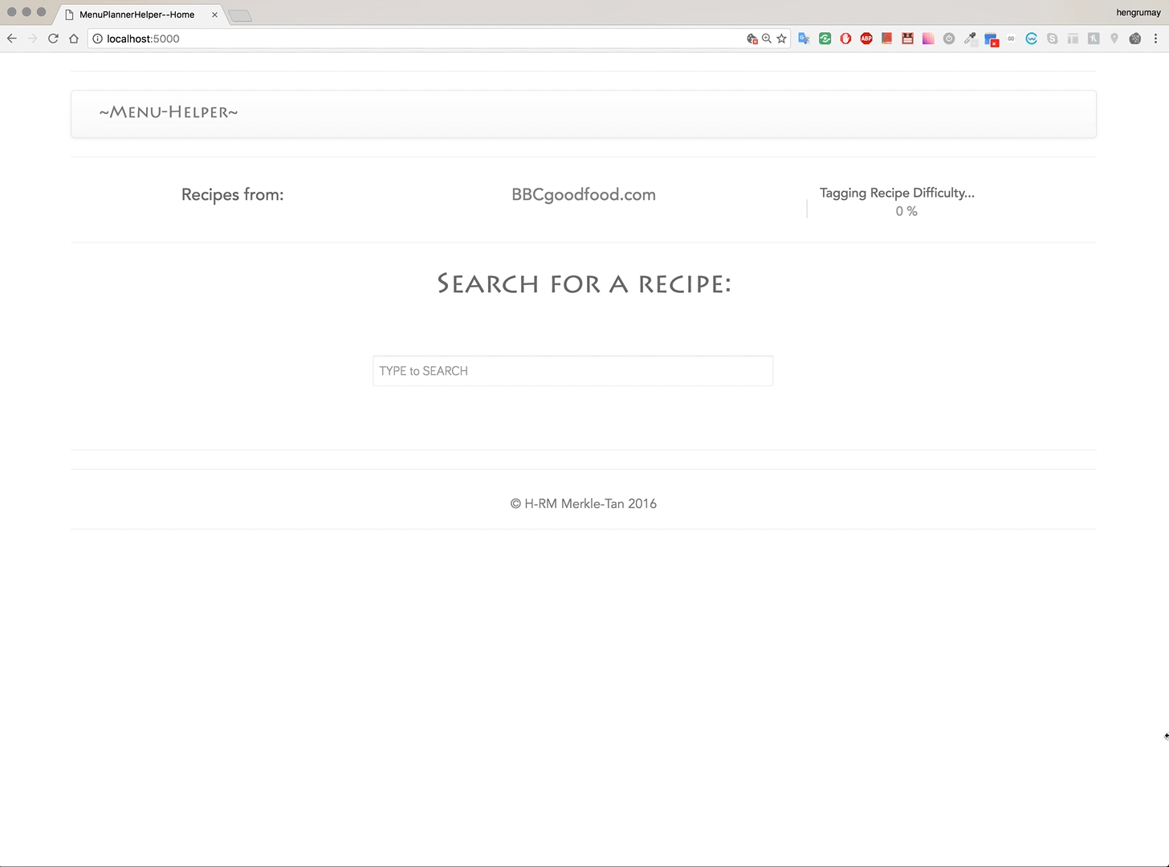
Menu Helper

Slide 11
Conclusion / Extensions
Tag other recipe sites and test recipe similarity suggestions
Collect users’ feedback to assess and update model
Personalized ‘learning’ tool: tailoring your cooking adventure – where the model could be adapted with user’s experience

Slide 12


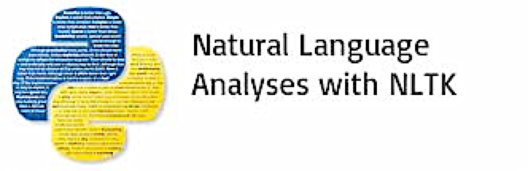


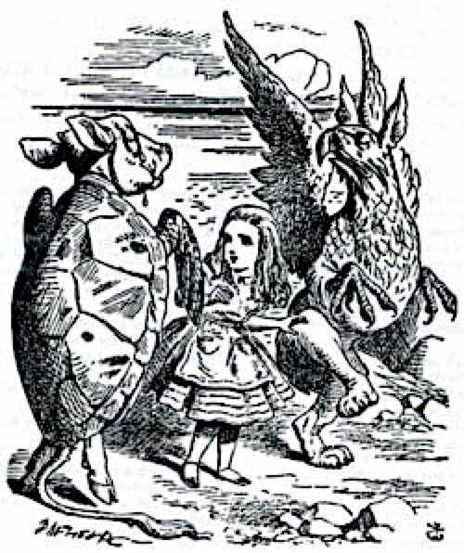





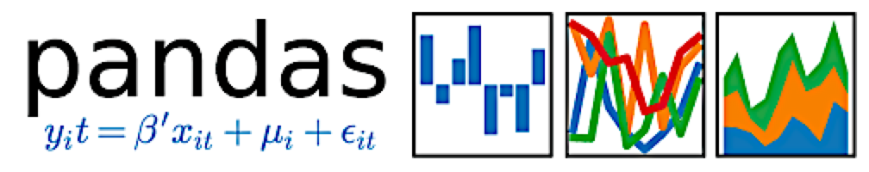




Menu Helper
With thanks to:
May Merkle-Tan, PhD
hengrumay@gmail.com
github.com/hengrumay
www.linkedin.com/in/hengrumay

